Slide 1
Project By Gayatri Anant Gomewadikar R.I.T. College , Islampur CS & IT Department Div. - I PRN No. - 2010044

Slide 2
Festivals in Germany
Karneval
Oktoberfest
Wurstmarkt
Reeperbahn
Berlinale Film Festival

Slide 3
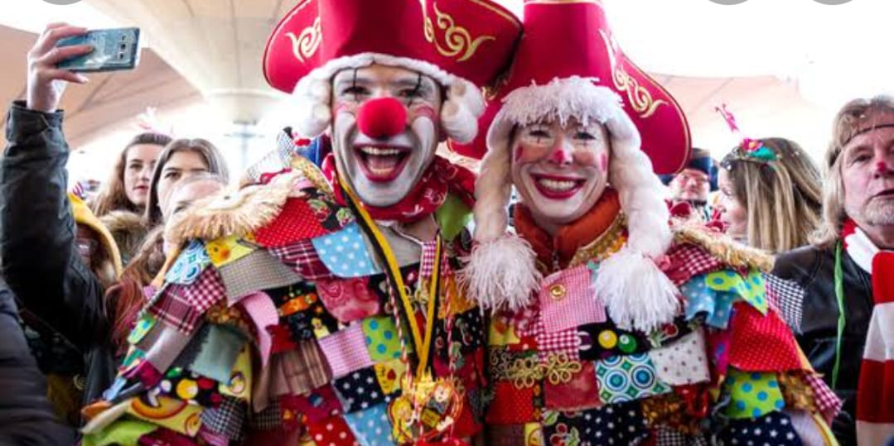
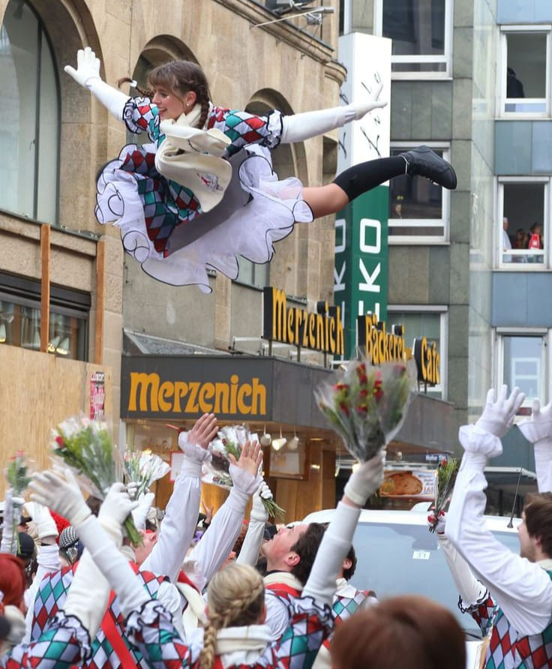
Karneval

Slide 4
Karneval in cologne feels like a massive costume party that lasts for about 6 days in the month of february, from thursday to tuesday. Expect lots of traditional music, dance and live performances during the day, followed with more parties and street shows well into the night. Situated on the mighty rhine river, cologne is one of germany’s oldest cities. It houses the unesco-listed cathedral (kölner dom) of cologne, an incredible example of gothic architecture. Karneval in cologne is one of the biggest street german festivals, with over a million people out on the streets to watch the colorful parade and marching bands.

Slide 5

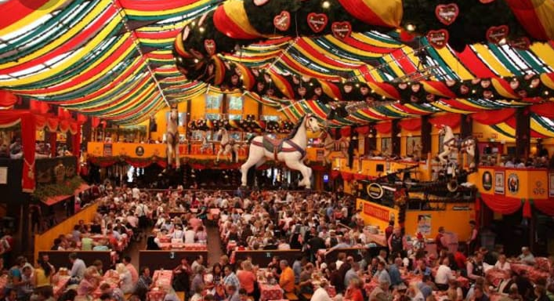
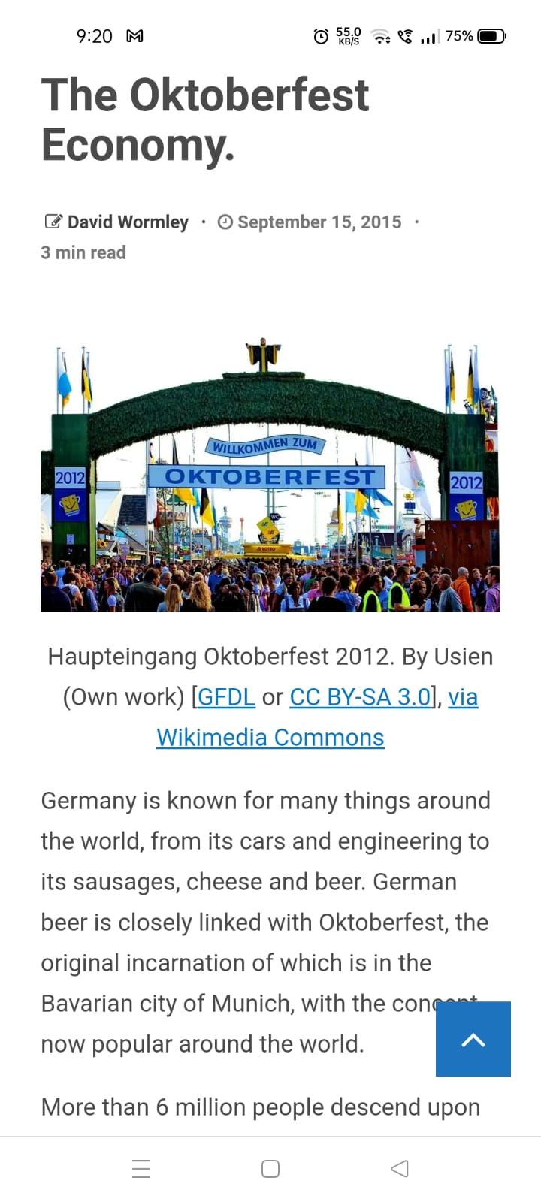
Oktoberfest

Slide 6
The Oktoberfest is the world's largest volksfest (beer festival and travelling funfair). It is held annually in munich, bavaria, germany. It is a 16 to 18 day folk festival running from mid- or late september to the first sunday in october, with more than six million people from around the world attending the event every year. The oktoberfest is an important part of bavarian culture, having been held since the year 1810. Other cities across the world also hold oktoberfest celebrations that are modeled after the original munich event . During the event, large quantities of oktoberfest beer are consumed. Visitors also enjoy numerous attractions, such as amusement rides, sidestalls, and games. There is wide variety of traditional foods available.

Slide 7
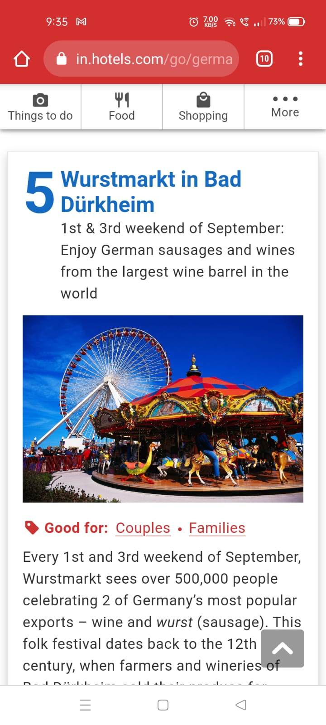
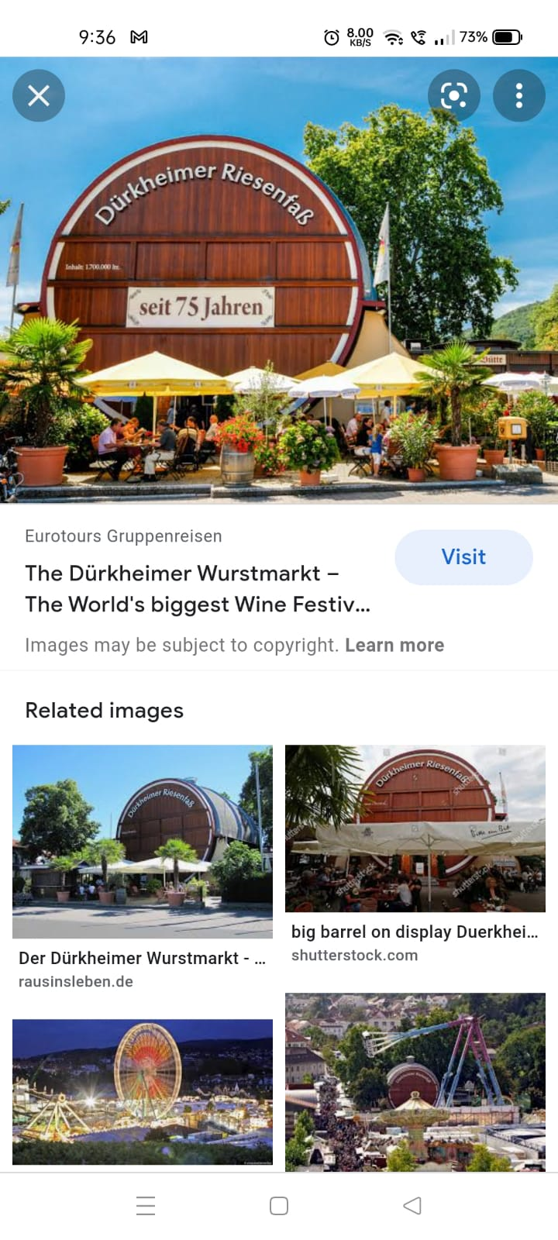
wurstmarkt

Slide 8

Every 1st and 3rd weekend of september, wurstmarkt sees over 500,000 people celebrating 2 of germany’s most popular exports – wine and wurst (sausage). This folk festival dates back to the 12th century, when farmers and wineries of bad dürkheim sold their produce for pilgrims heading up to michaelskapelle (st. Michael’s chapel). Today, it’s a fair-like event with hundreds of food stalls, carnival rides, fireworks displays, and wine halls. One of the best spots to celebrate wurstmarkt is at durkheimer riesenfass, which is a gigantic wine barrel with an onsite restaurant.

Slide 9
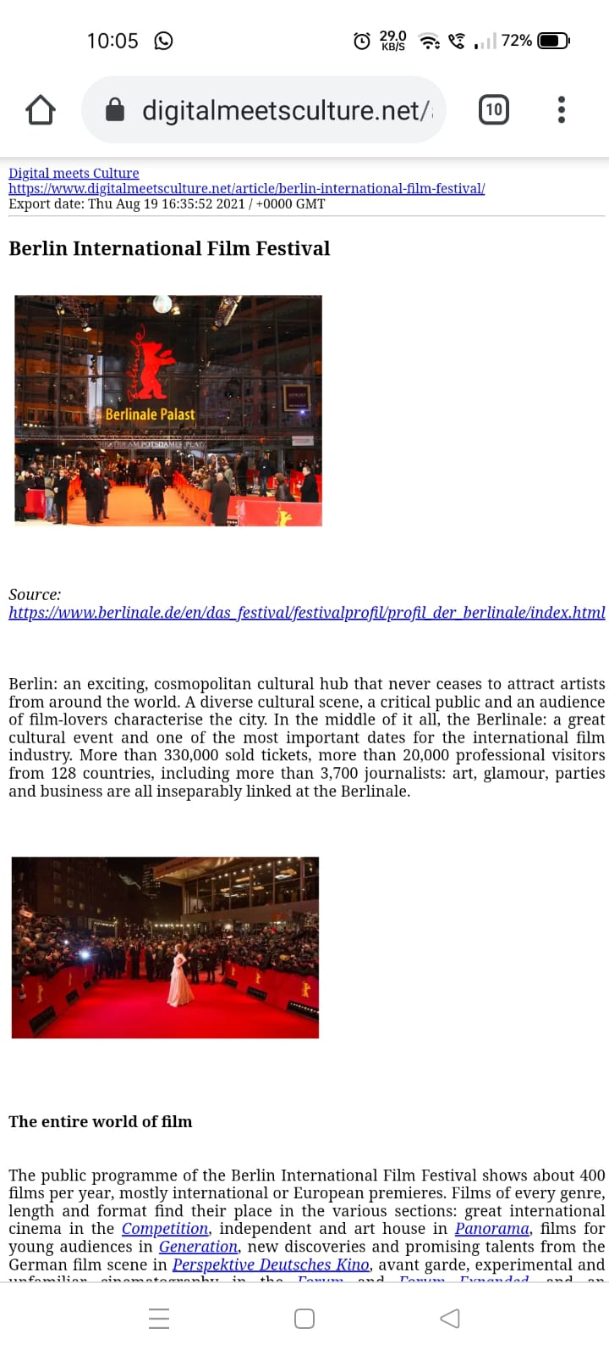
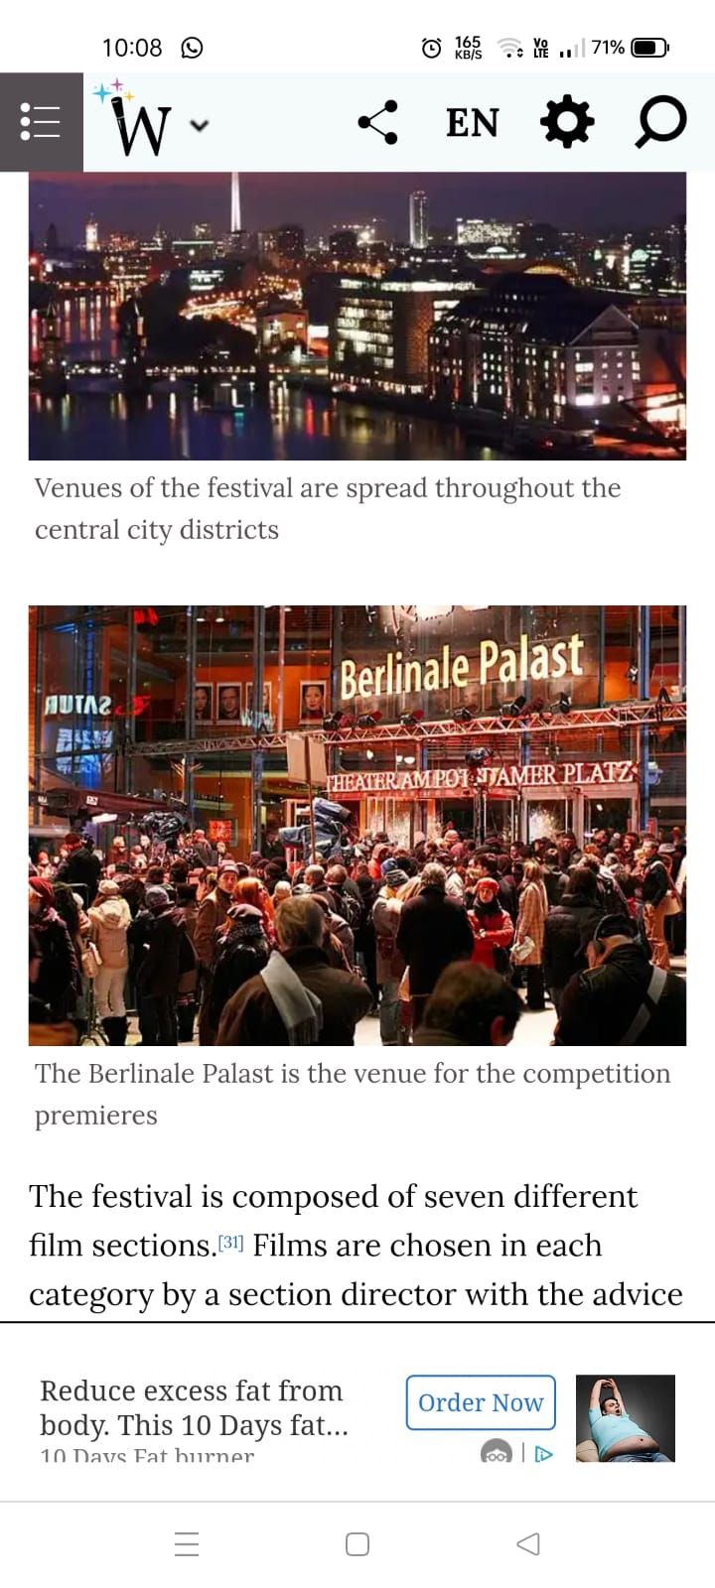
Berlinale film festival

Slide 10
It is the largest international film fest in the world, the berlinale has been held annually since 1978. With more than 400 films screened, all competing for 20 prizes called gold or silver bears, the berlinale showcases the world’s elite cinematic talent in most every genre. Berlinale german festivalsthe berlin international film festival is one of europe’s most prestigious red-carpet events. Although it is of the most hyped red-carpet events in all of europe, berlinale is distinct from many other film festivals in that it is accessible for people outside of the film industry. While many renowned film festivals are invite-only (cannes) or require purchasing an access badge for thousands of dollars (sundance, SXSW), berlinale sells public tickets for single screenings. And, at around 12 euros a pop, it’s really not much pricier than seeing a movie in theaters.

Slide 11
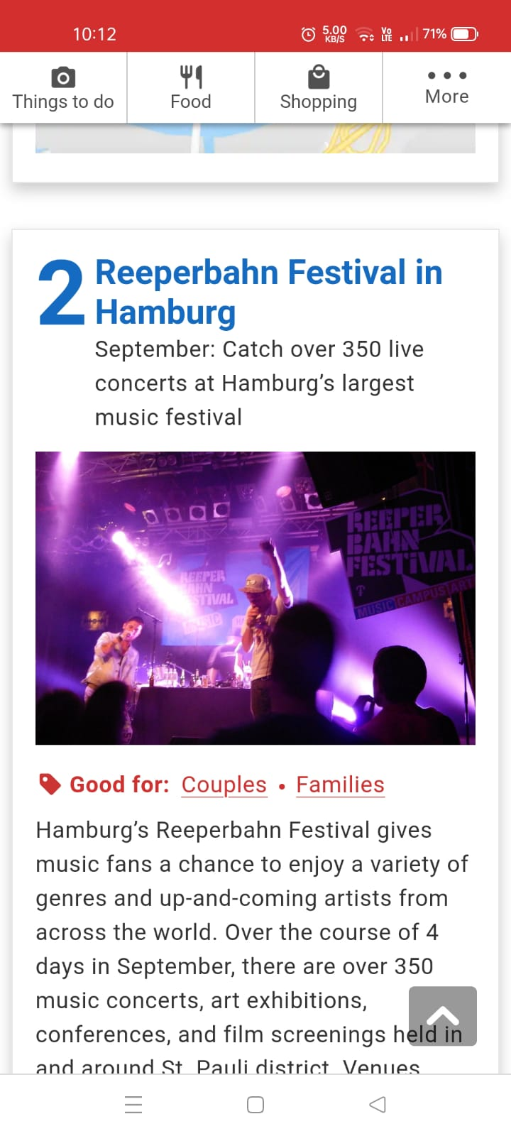
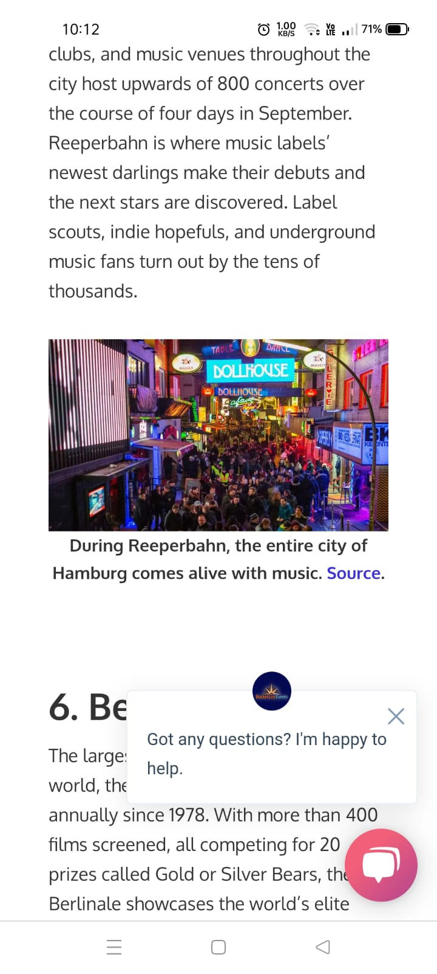
Reeperbahn

Slide 12
Europe’s largest club festival and the german equivalent of SXSW, Reeperbahn is a music festival spread out the beautiful northern port city of hamburg. Hamburg’s Reeperbahn Festival gives music fans a chance to enjoy a variety of genres and up-and-coming artists from across the world. Over the course of 4 days in September. Majority of bars, clubs, and music venues throughout the city host upwards of 800 concerts over the course of four days in september. Reeperbahn is where music labels’ make their debuts and the next stars are discovered.. Over the course of 4 days in September, music concerts, art exhibitions, conferences, and film screenings held in and around St. Pauli district. Venues range from underground clubs and bars to grand buildings such as Imperial Theatre, Schulmuseum and St. Pauli Cathedral.

Slide 13
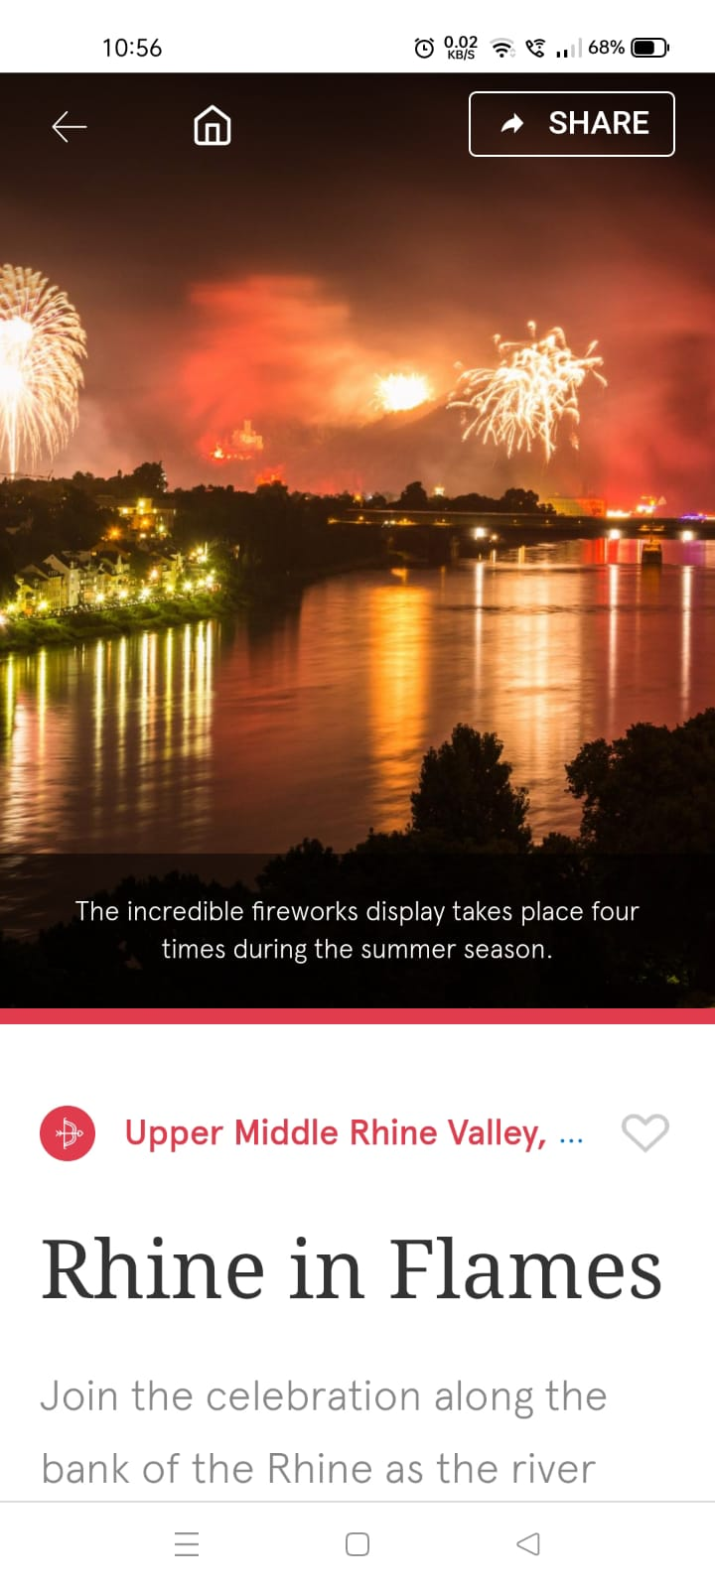
Thank you

